Slide 1
Rekayasa Perangkat Lunak Spesifikasi Kebutuhan P/L
Sumber: Roger S. Pressman; Software Engineering: A Practitioner's Approach (7thEd.); Mc Graw-Hill, 2010

Slide 2
IEEE Std 830
IEEE Std 830 – 1998 (Revision of IEEE Std 830 - 1993)
IEEE Recomended Practice for Software Requirements Specifications

Slide 3
Standard lain?

Slide 4
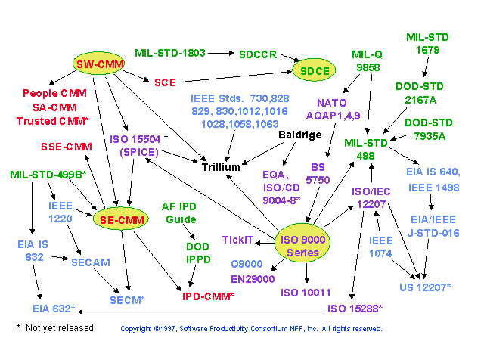
Don’t Get Caught in the Standards Quagmire
From An Introduction to IEEE/EIA 12207 by Jim Wells - Software Engineering Process Office (SEPO - D12)
Software Process Improvement Working Group (SPIWG) October 13, 1999
Notes:
An Introduction to IEEE/EIA 12207
by Jim Wells - Software Engineering Process Office (SEPO - D12)
Software Process Improvement Working Group (SPIWG)
October 13, 1999

Slide 5
Why Use Standards?
Establish uniform requirements for development and documentation
Define a common framework for software life cycle processes
Clarify the roles and interfaces of participants
Clarify the types and contents of documentation
Identify the tasks, phases, baselines, reviews, and documents needed
Follow the lessons learned and best practices of the industry
Avoid the pitfalls and problems of the past
From An Introduction to IEEE/EIA 12207 by Jim Wells - Software Engineering Process Office (SEPO - D12)
Software Process Improvement Working Group (SPIWG) October 13, 1999
Notes:
An Introduction to IEEE/EIA 12207
by Jim Wells - Software Engineering Process Office (SEPO - D12)
Software Process Improvement Working Group (SPIWG)
October 13, 1999

Slide 6
Software Standard
Definition: Mandatory requirements employed and enforced to prescribe a disciplined uniform approach to software development, that is, mandatory conventions and practices are in fact standards (IEEE Standard Glossary of Software Engineering Terminology, 1990)

Slide 7
The Evolution of Standards Affecting DoD Software Development
MIL-STD-1679A Software Development 1983
DOD-STD-2167A Defense System Software Development 1988
DOD-STD-7935A AIS Documentation Standards 1988
MIL-STD-498 Software Development and Documentation 1994 (SecDef Perry Memo - June 1994)
ISO 9000 (series - on Quality Management, etc.) 1991-
J-STD-016-1995 Software Development - 1995 Acquirer-Supplier Agreement
ISO/IEC 12207 Information Technology - Software Life 1996 Cycle Processes
IEEE/EIA 12207 Software Life Cycle Processes 1998
From An Introduction to IEEE/EIA 12207 by Jim Wells - Software Engineering Process Office (SEPO - D12)
Software Process Improvement Working Group (SPIWG) October 13, 1999
Notes:
An Introduction to IEEE/EIA 12207
by Jim Wells - Software Engineering Process Office (SEPO - D12)
Software Process Improvement Working Group (SPIWG)
October 13, 1999

Slide 8
The Family Tree of Standards
ISO/IEC 12207 “Software Life Cycle Processes” Aug 95
DOD-STD-2167A “Defense System Software Development” Feb 88
ISO 12207
IEEE Stds
2167A
498
016
IEEE/EIA 12207
7935A
MIL-STD-498
“Software Development and Documentation” Dec 94
J-STD-016-1995
(Trial Use)
“Software Life Cycle Processes, Software Development” Sep 95
IEEE/EIA 12207.0-1996
IEEE/EIA 12207.1-1997
IEEE/EIA 12207.2-1997
“Software Life Cycle Processes”
Mar/Apr 98
DOD-STD-7935A “DoD Automated Information Systems (AIS) Documentation Standards” Oct 88
From An Introduction to IEEE/EIA 12207 by Jim Wells - Software Engineering Process Office (SEPO - D12)
Software Process Improvement Working Group (SPIWG) October 13, 1999
Notes:
An Introduction to IEEE/EIA 12207
by Jim Wells - Software Engineering Process Office (SEPO - D12)
Software Process Improvement Working Group (SPIWG)
October 13, 1999
Animation - figures and text fly in from left automatically
This shows that 2167A and 7935A were combined and replaced by 498; 498 became the basis for J-STD-016 (along with portions of ISO 12207)
IEEE 12207 includes all of ISO 12207 and good parts of 016 (=498)

Slide 9
Characteristics of a good SRS
Correct
Unambiguous
Complete
Consistent
Ranked for importance and/or stability
Verifiable
Modifiable
Traceable

Slide 10
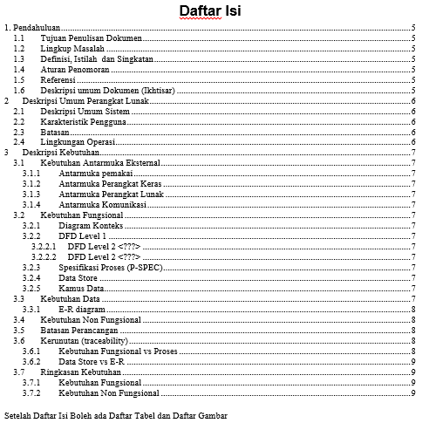
Template SRS

Slide 11
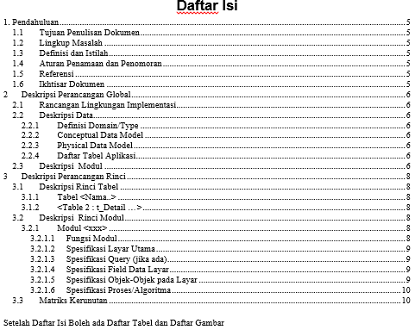
Template SDD (Software Design Documentation)

Slide 12
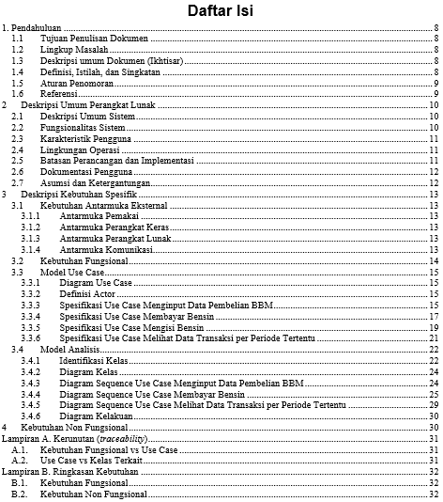
Template SRS (disesuaikan dengan Object Oriented - contoh)

Slide 13
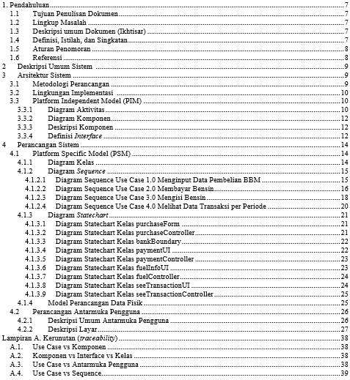
Template SDD (diseuaikan dengan Object Oriented - contoh)

Slide 14
Template dan contoh
Lihat contoh file dokumen SRS yang diberikan

